Slide 1
FTMS MANAGER
Group 11 :
Mary ann chev
Benjamin Willetts
Brent coutts
Rony azrak

Slide 2
Introduction
The Food Truck Manager System (FTMS) supports the managers of food trucks by keeping track of staff schedules, equipment, food supply levels, and menu item and their popularity in one central location.
The platform use to implement the system are :
Desktop/laptop platform using Java Swing Framework
Android platform using UI development Framework with Android Studio
Web platform using web server and PHP

Slide 3
Functional requirements schedule system
The system shall be able to :
Add an employee to the staff list as well as their role and the number of hours expected to work in a week.
Able to display the staff list
Add a weekly schedule to the schedule list as well as the date, start time and end time.
Able to display the schedule list
Register an employee to a time slot in the schedule.

Slide 4
Functional Requirements Inventory
The system shall be able to :
Add or choose a food supply to the inventory system with the respective quantity
Display the food supply list
Add an equipment to the inventory system with the respective quantity
Display the equipment list

Slide 5
Functional requirements menu & menu tracker
The system shall be able to :
Add or choose a Menu with the corresponding ingredients and quantity per serving .
Track popularity of the menu by implementing the quantity sold per day.

Slide 6
Non- functional requirements
The programs should be:
Able to display weekly schedules list, inventory lists with their quantities and menu list with their popularities.
Persistent, allows data to be accessible even after a crash or a shutdown of the program
easy to use, reliable, quick to restart and restrictive( some feature should not be accessible to the user)

Slide 7
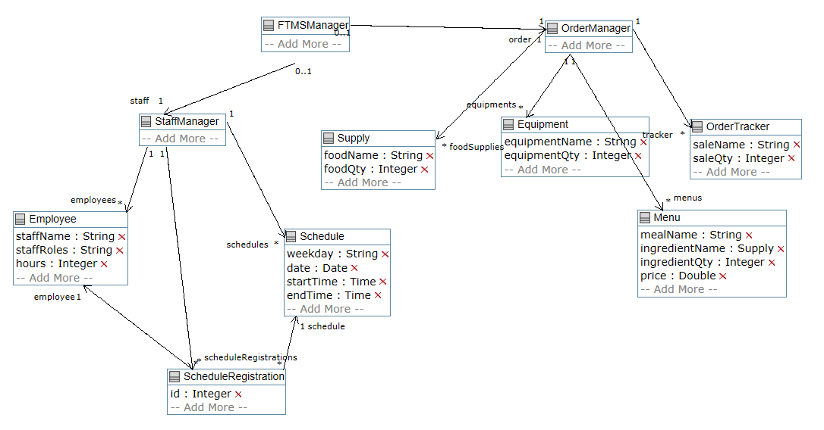
Domain model

Slide 8
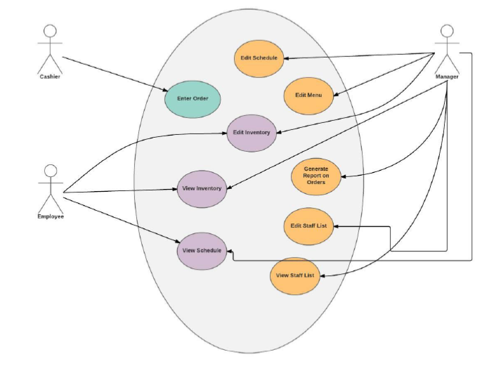
User diagram
Manager :
Edit schedule
Edit inventory
Edit menu
Generate reports on orders
Edit staff list
View staff list

Slide 9
User diagram
Employee :
Edit inventory
View inventory
View schedule
Cashier
Enter order

Slide 10
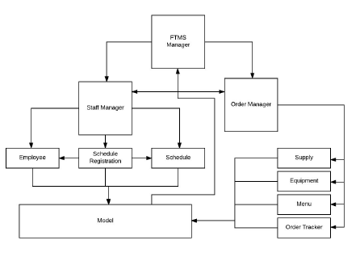
Design architecture (mvc type)
FTMS Manager splits into two sub-managers:
Staff manager
Order manager

Slide 11
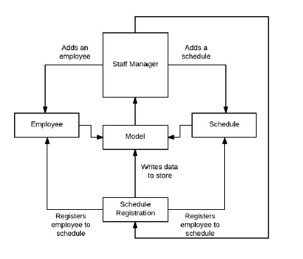
Staff manager architecture
Staff manager connects with the Employee and schedule by adding instance of each objects
Staff manager also connects to the schedule registration to process the command of registering an employee with a timeslot in the schedule

Slide 12
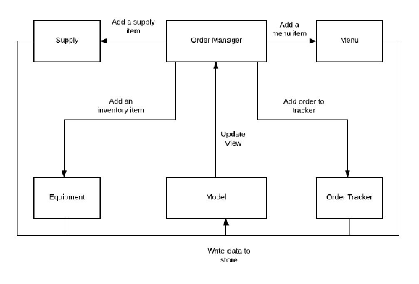
Order manager architecture
Order manager connects to :
Supply
Equipment
Menu
Order tracker (menu tracker)

Slide 13
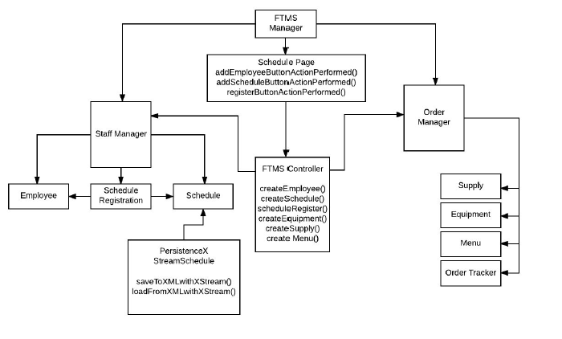
Class diagram for ftms application

Slide 14
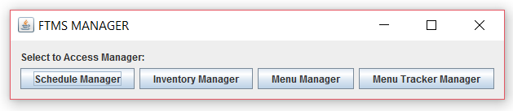
Desktop/laptop platform start-up view
All manager are implemented so that they have several views

Slide 15
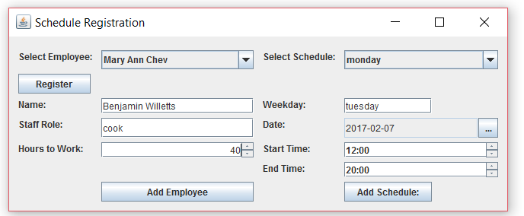
Desktop/laptop platform schedule manager view

Slide 16
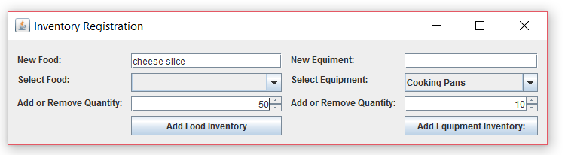
Desktop/laptop platform inventory manager view

Slide 17
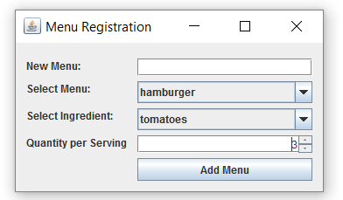
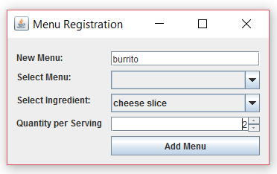
Desktop/laptop platform menu manager view

Slide 18
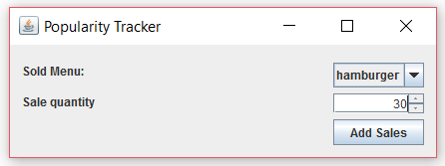
Desktop/laptop platform menu tracker manager view

